Slide 1
VANUATU TEACHERS UNION / SYNDICAT DES ENSEIGNANTS DE VANUATU
HeadOffice Port-Vila, Efate - Tel. (678) 23679 / 24707 - Fax (678)26903 Email vtusev@vanuatu.com.vu - PO Box 287
SANMA ADVOCACY& TRAINING– JANUARY 2026
Prepared and presented by: Annette Daniel – National Treasurer.

Slide 2
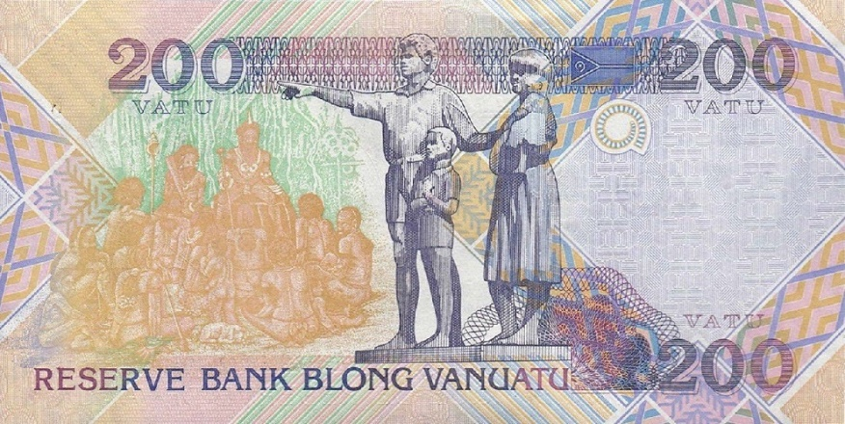

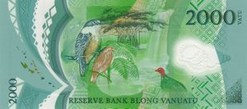
Tu taosen tu hanred & fifty vatu blong yu
This Photo by Unknown Author is licensed under CC BY-SA
This Photo by Unknown Author is licensed under CC BY-SA
(2 250VATU WE I GO LONG VTU/SEV)

Slide 3

VTU/SEV KONTRIBUSEN
  2, 250VATU I kamaot long salari blong yu long evri fotnaet.
  Hemia emi infomesen blong YU olsem wanem kontribusen blong YU i stap givhan long UNION BLONG YU.
  TAEM YU KAM WAN FAENANSEL MEMBA BLONG VTU/SEV, EMI MINIM SE YU MAS KAREM ONASIP LONG UNION YA.
  UNION YA, VTU/SEV EMI UNION BLONG YU MO YU GAT RAET BLONG SAVE ABAOT HEM!!!
2, 250vatu

Slide 4


FAENANS EMI BLAD BLONG ENI ORGANAESEN, GRUP, O UNION
  Sapos union i nogat mane, bambae hem i no save ron gud.
  Mo bambae ol samting we yumi wantem ol boss blong yumi i mekem blong yumi glad long ples blong wok blong yumi, bae i had blong yumi ajivim.

Slide 5
BREKDAON BLONG SUBS ,2250VT
150VT
900VT
500VT
500VT
200VT
Government Commission
VTU Admin
VTU Medical
VTU Retirement Benefit
VTU Savings & Investment

Slide 6


OL SAVINGS BLONG YU:
200VATU
  Hemia emi savings blong yu.
  Long wan yia, 200vatu blong yu i kasem 5,200vatu.
  Mane ya emi no blong yu blong tadjem.
  VTU/SEV emi stap lukaotem mane ya blong yu go kasem taem we yu ritae long hem.
Ritaemen

Slide 7
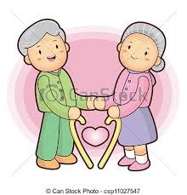
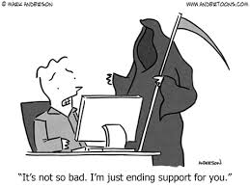
OL RITAEMEN MO DED BENEFIT BLONG YU:
500VATU
  50% - Widro long membasip
  75% - Ritaemen blong yu
  Haf we i stap i kavremap ol kolik we oli lusum spaus o pikinini blong olgeta.
  Hemia givhan blong yu long wan fren o kolik blong yu.
  I save happen se yu nao ol fren oli helpem famle blong yu.
20, 000vatu

Slide 8
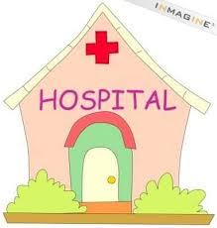
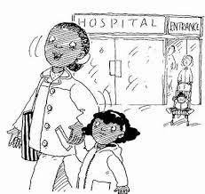
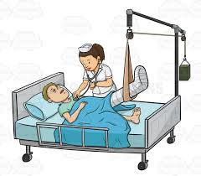


MEDICAL BENEFIT BLONG YU:
(Not Refundable)
500VATU
  20 000vatu – Land transport
  20 000vatu – Air transport
  20 000vatu – Sea transport
  15 000vatu – Maternity
  (100% if life threatening)
  20 000vatu – Dental (famle)
  20 000vatu – Optical (memba)
  20 000vatu – Massage
  (50 000vatu – Oversea Treatment )
  60 000vatu – Consultation/ Medication
  100% - Evacuation from island to nearest hospital
Solidarity Fund

Slide 9
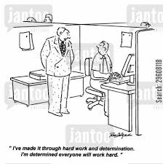
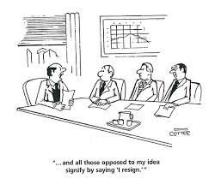
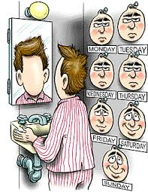
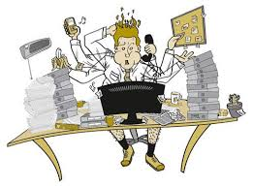
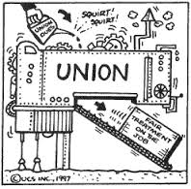
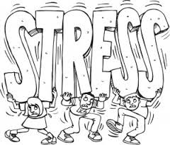
ADMINISTRATION – 900 VATU
(900 – 250 = 650 Vatu)
Mani ya hemi givhan blong ranem ofis blong Yu. Hemi go blong pem evri samting wan ofis administresen hemi nidim blong ofis i wok gud.
Hemia i mekem se ol ofisa oli save riprisentem yu long wan miting o wan nigosiesen.

Slide 10
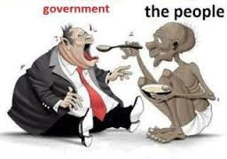

GOVERNMENT COMMISSION (400VATU):
  Dipatmen blong faenans i stap
  karemaot 250vt admin fee mo 150vt commission out long
  2 250vatu blong yu long evri fotnaet.
  Mane ya i go bak long basket blong gavman blong helpem hem long ol nara divelopmen we i stap.

Slide 11


Tank yu blong lisen.
God I blesem yumi evriwan

